Slide 1

Social Mission Locking

Slide 2
Types of Mission Locks
Charities (trusts, CIOs, Charitable Company)
  https://www.gov.uk/setting-up-charity/structures
Asset locks (CIC without share capital, CIC with share capital)
  https://assets.publishing.service.gov.uk/government/uploads/system/uploads/attachment_data/file/605418/14-1089-community-interest-companies-chapter-6-the-asset-lock.pdf
Social Mission Locks (applicable to companies limited by guarantee and companies limited by share)
  Golden Share
  Social Purpose in Articles (e.g. B-Corps)
  Social Purpose in Articles Protected by Supermajority Clause

Slide 3
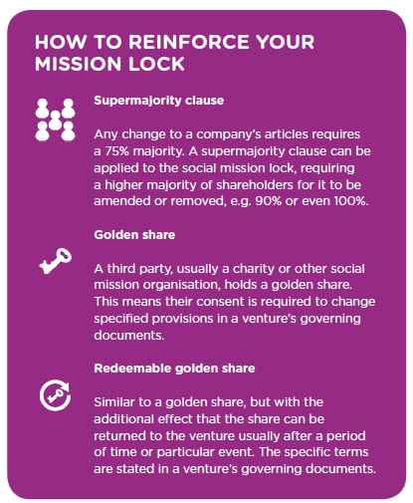

Slide 4
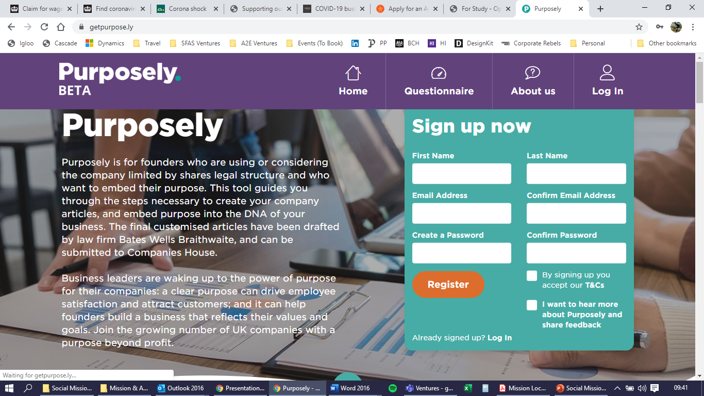
Tools to Help You Create A Social Mission Lock
The “Purposely” tool can help you create a social mission lock within a company limited by shares.
https://getpurpose.ly/

Slide 5
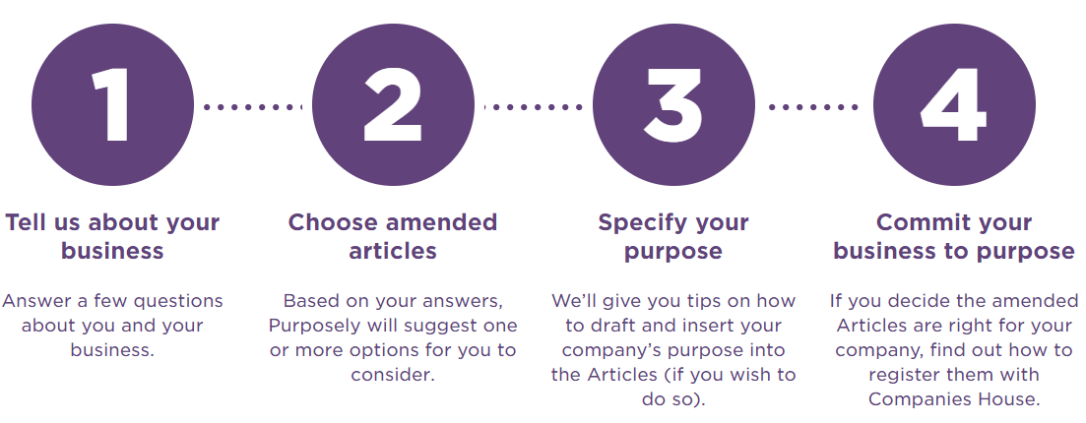
Tools to Help You Create A Social Mission Lock
The “Purposely” tool can help you create a social mission lock within a company limited by shares.
https://getpurpose.ly/

Slide 6
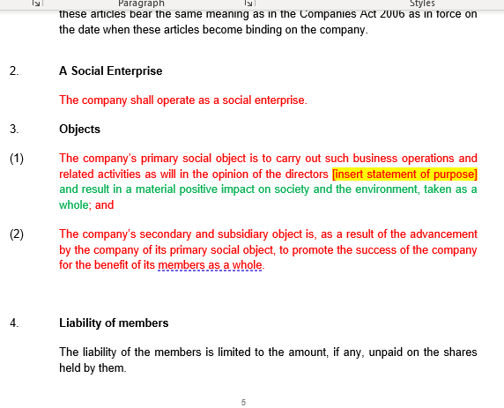
Tools to Help You Create A Social Mission Lock
The “Purposely” tool can help you create a social mission lock within a company limited by shares.
https://getpurpose.ly/

Slide 7
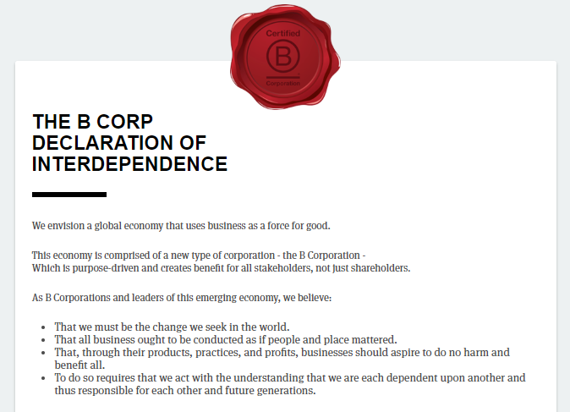
Tools to Help You Create A Social Mission Lock
B-Corps
B Corp Certification doesn’t just evaluate a product or service; it assesses the overall positive impact of the company that stands behind it.
Certified B Corporations achieve a minimum verified score on the B Impact Assessment and make their B Impact Report transparent on bcorporation.net. Certified B Corporations amend their legal governing documents to require their board of directors to balance profit and purpose.
The combination of third-party validation, public transparency, and legal accountability help Certified B Corps build trust and value. B Corp Certification is administered by the non-profit B Lab.
https://bcorporation.uk/

Slide 8
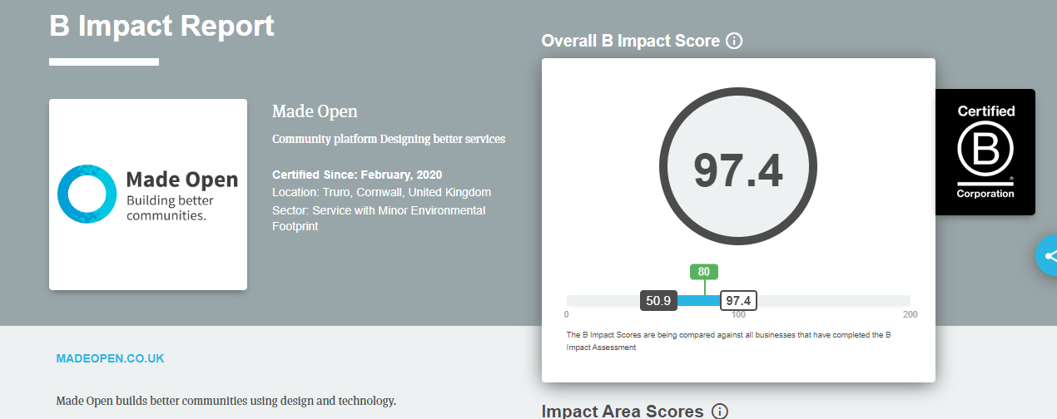
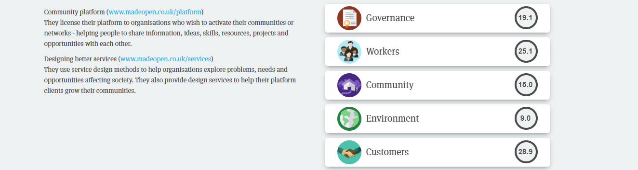
Tools to Help You Create A Social Mission Lock
Note on B-Corps:
Whilst this public transparency and commitment with B-Corps certification does demonstrate an operational commitment the “lock” it provides is most similar to a “social purpose statement” in the articles and isn’t “locked” against any resolutions with a company’s articles
Charities can’t be B-Corps
The assessment process is free to do and very rigorous but is a very helpful process that provides an audit to the business
There is a sign-up fee
Website is very helpful: https://bcorporation.uk/

